Slide 1


DEALER TRAINING
Part 2: Premium Whole Home Filtration
Advanced Water Filtration for a Healthier Home
Notes:
IIII

Slide 2
Why Clean Water Matters
Contaminants like chlorine, iron, arsenic, and sediment affect taste, and health.
Hard water affects the longevity of appliances.
Standard water treatment may not remove everything.
A whole home system protects your family, plumbing, and appliances.

Slide 3
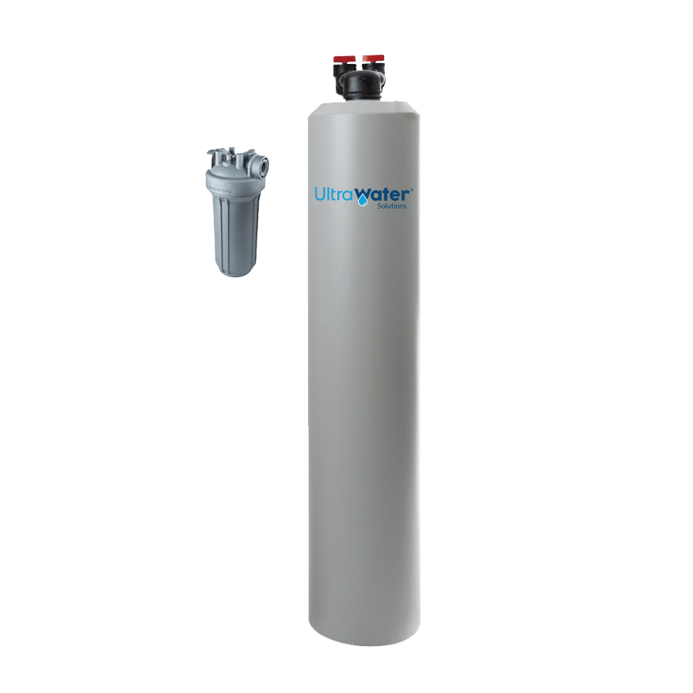
UltraWater Solutions Premium Filtration
Better Tasting, Safer Water. Designed to provide clean, high-quality water throughout your entire home.
Using high-quality USA-sourced media, it effectively reduces:
  Chlorine
  Chloramine
  Sediment
  VOCs
  …and 229 others!
Available in Standard and Grande sizes for various needs.
Optimal performance depends on sizing to a variety of factors, including:
  # of bathrooms
  Water usage
  How many people live in the home
  Pipe size
  Square footage

Slide 4
Different Types of Water Sources / Who Needs Premium Filtration?
City Water: The Reality
Treated water by the municipality
Often treated with chlorine or chloramines (causing odor, taste issues, dry skin, etc.)
Can contain other contaminants like forever chemicals, pharmaceuticals, pesticides, heavy metals, etc.
No lab test generally required
Well Water: The Reality
Not regulated by municipal testing – your responsibility
May contain iron, hydrogen sulfide (usually indicated by rotten egg smell), bacteria, nitrates, pesticides, arsenic, etc.
Often higher hardness
We require a lab test
The Premium Filtration Tank is an ideal first line of defense for homeowners on either city or well water.
For city water customers, it helps reduce exposure to treatment chemicals like chlorine and chloramines, as well as contaminants that may leach in from aging pipes on the way to the home.
For well water customers, it provides reliable protection against many of the most common naturally occurring or agricultural contaminants often found in private wells.
By addressing both municipal and private water concerns, the Premium Filtration Tank delivers a strong foundation of cleaner, safer water throughout the entire home.

Slide 5
Setting the Right Expectations
Every Customer’s Water is Different. Repeat. EVERY CUSTOMER’S WATER IS DIFFERENT.
Efficiency and performance heavily depend on source water quality.
Things that can affect performance:
  pH
  Hardness
  Extremely high levels of chlorine / chloramines
  Water flow rate
  Water temperature
Although our Standard System will generally meet the needs of your customer, it’s important to always keep in the back of your mind that there’s no ’one-size-fits-all’ answer.
Two homes on the same street can have very different water profiles. This is where the Pre-Sale Questionnaire comes in handy and can help you to determine the customer’s specific needs in their home and how we can help.

Slide 6
Add-Ons to the Premium Tank
The Premium Tank is your first line of defense. For specific water challenges, we can tailor a solution.
Additional protection offerings include:
IronGuard – helps to reduce iron and Hydrogen Sulfide (rotten egg smell)
UV disinfection – Helps to neutralize bacteria, viruses and microorganisms
Ozone – Powerful oxidation for bacteria, odor, and organic contaminants
Salt-free conditioner – reduces scale without ion-exchange (sodium or potassium) – effective up to 17 GPG of hardness
Salt-based softener – proven method to eliminate hardness minerals through sodium ion-exchange – effective for extreme hardwater areas. Requires use of RO with ionizer.

